Slide 1
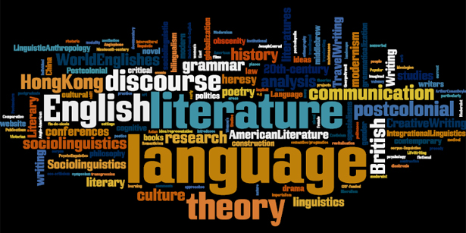
WELCOME TO
THE DEPARTMENT OF ENGLISH
A.B.M College, Jamshedpur

Slide 2
DEPARTMENT OF ENGLISH
PROFILE
YEAR OF ESTABLISHMENT:-
The department of English was established in 1979. Since the beginning, we have been making effort to improve the overall standard of our students. We nurture the creative skills alongside the curricular studies, and encourage active participation in various literary and cultural activities. We instill value and motivate our students to make efforts in doing their best, making improvement each year to achieve greater heights.

Slide 3
OUR BELIEF
KNOWLEDGE AND FAITH SHOULD GROW MORE AND MORE MAKING THE HUMAN LIFE ENRICHED

Slide 4
OBJECTIVE
Educate students in both the artistry and utility of the English language through the study of literature and other contemporary forms of culture.
Provide students with the critical faculties necessary in an academic environment, on the job, and in an increasingly complex, interdependent world.
Graduate students who are capable of performing research, analysis, and criticism of literary and cultural texts from different historical periods and genres.
Assist students in the development of intellectual flexibility, creativity, and cultural literacy so that they may engage in life-long learning.

Slide 5
VISION
To provide appropriate pedagogies - including class size - and environments (classrooms, equipment, resources, and technology) that will lead student retention and success.
To help students see themselves as professionals, as part of a discipline with skills and abilities valuable in the business, teaching, publishing, or post-graduate work.
To give students a sense of themselves as citizens of a larger community by encouraging participation in service learning and in diverse and international course work and programming.
To assure that students encounter creativity crucial to English studies through theater productions, readings by professional writers, and their own creative and critical production and presentation.
To balance the needs of general education - communication, diversity, global perspectives, interdisciplinary studies.

Slide 6
The Present Team
Presently, the Department of English comprises the following three staff members:
Prof. Bishnupriya Maharatha (Head of Department)
Mr. Manish Prabhakar Singh (Guest Faculty)
Miss. Purnima Kumari (Guest Faculty)

Slide 7
FACULTY PROFILE
Prof. Mrs. Bishnupriya Maharatha
Area of Specialization- American Literature
Teaching Experience: 33 years
Areas of Interest: Drama, Poetry, Literary History, Literary Theory & Criticism, Culture Studies, Film Studies, Translation Studies.

Slide 8
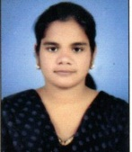
FACULTY PROFILE
Miss. Purnima Kumari
Area of Specialization- Australian and Canadian Literature
Serving since 2019 – till Date
Areas of Interest: British Drama, British Novel, Literary History, Literary Theory & Criticism, Commonwealth Literature, Translation Studies, Diaspora Studies

Slide 9
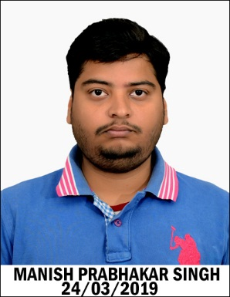
FACULTY PROFILE
Mr. Manish Prabhakar Singh
Area of Specialization- American Literature
Serving since 2019 – till Date
Seminars/Conferences attended: 1
International: 01
Workshops participated in: 2
Areas of Interest: British Drama, Poetry, Literary History, Literary Theory & Criticism, Culture Studies, Film Studies, New Literature, Feminist Studies, Linguistics.

Slide 10
Departmental Events
Departmental Induction
Film Screening (Syllabus Based)
Student Seminars (Syllabus Based)
‘Alumnus Speaks’ – An Interactive Session with Seniors
Parent-Teacher Meeting
Alumni Meet

Slide 11
Teaching methods adopted to improve student learning
Special interactive classes by applying Group Discussion, Question-Answer, Demonstration method are arranged to encourage the students and thereby improve their learning.
In-House seminars frequently organized by the department help the students acquire knowledge, skill and self-confidence.
The hidden creativity of the students is manifested through the publication of Wall Magazines and Poster Exhibition in the department.
Classes are taken through the use of technology by means of Slide Show Presentation etc.
Interest is grown among the learners by showing them films on different dramas and novels in the syllabus

Slide 12
SWOC Analysis
STRENGTH:-
The teachers of the department are academically motivated to bring out the best in their students, to which effect, they constantly keep themselves updated in their respective areas of specialization.
The students of the department are equally motivated and register enthusiastic presence and participation in all the activities of the department. The department has also constituted a Core Team of sincere and dedicated students volunteers who assist in the administrative functioning of the department.

Slide 13
The Department is highly active and routinely organises a large number of activities such as film shows, guest lectures, poetry and prose reading sessions, centenary celebrations of writers and their works, etc. in order to offer its students opportunities of broadening their perspective on literature.
The Department also organizes extra classes on writing skills for students in order to train them in the art of writing academic answers for university examinations.
The greatest strength of the department has been the teacher-student intimate relationship that has kept the department alive.

Slide 14
Weaknesses
The Department suffers from the non-availability of good reference books for its students.
Lack of parental interest and concern in the learning and education of students also constitutes a handicap.
The fact that most of our students come from the economically under-privileged sections of society, makes it difficult for them to spend money on books of the subjects.
The vernacular background of the majority of our students is also an obstacle that necessitates the imparting of bilingual, sometimes multilingual instruction in the classroom.

Slide 15
Opportunities
The use of the ICT resources of the college also constitutes an important opportunity for the department.
The use of social media platforms for communications with students and promotion of learning opportunities is also visualized as an opportunity.
The students of the department constitute an important bank of creative talent for various literary and cultural activities both within and outside the college.

Slide 16
Challenges
The job mind-set of students and their evaluation of academic learning in vocational terms constitute a significant challenge.
Enabling students to distinguish between sound and unsound e-resources and discouraging unethical acts of plagiarism remains a challenge.
Motivating students for higher education and excellence in the subject, also constitutes a challenge.

Slide 17
Details of Infrastructural facilities
A well-equipped Central Library caters to the needs of the students. However, the specimen copies received from the publishers are preserved for the disposal of the students.
Internet facilities for staff and students are provided centrally.

Slide 18
CLASS DISTRIBUTION
TEACHER | CC | GE | MIL | DSC | TUTORIAL | AECC
B.P.MAHARATHA | 14 | 2 | 1 | 1 | 1 | 0
PURNIMA KUMARI | 10 | 1 | 6 | 3 | 1 | 1
MANISH PRABHAKAR SINGH | 9 | 1 | 4 | 1 | 1 | 5

Slide 19
ADMISSION DATA
YEAR | MALE | FEMALE | TOTAL | GENERAL | OBC | SC | ST
2013 | 12 | 14 | 26 | 15 | 5 | 3 | 3
2014 | 11 | 11 | 22 | 16 | 4 | 1 | 1
2015 | 10 | 14 | 24 | 22 | 0 | 0 | 2
2016 | 26 | 19 | 45 | 30 | 8 | 3 | 4
2017 | 14 | 20 | 34 | 26 | 2 | 0 | 6
2018 | 14 | 20 | 34 | 26 | 4 | 0 | 4

Slide 23
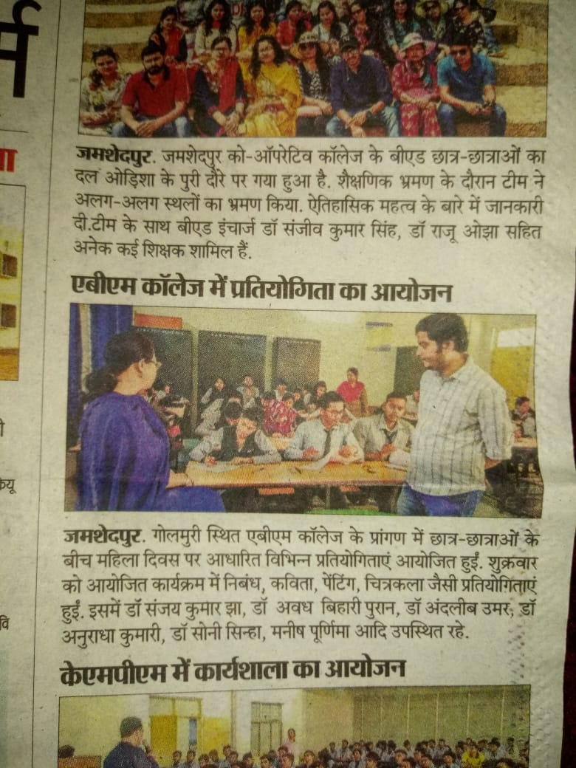
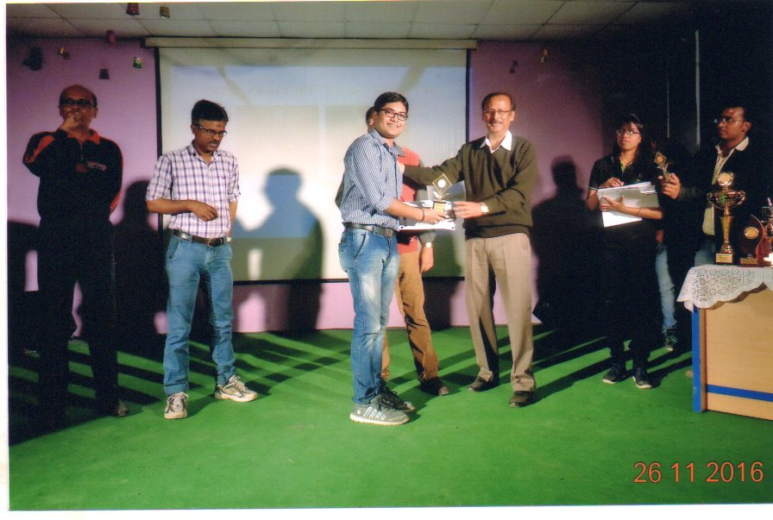
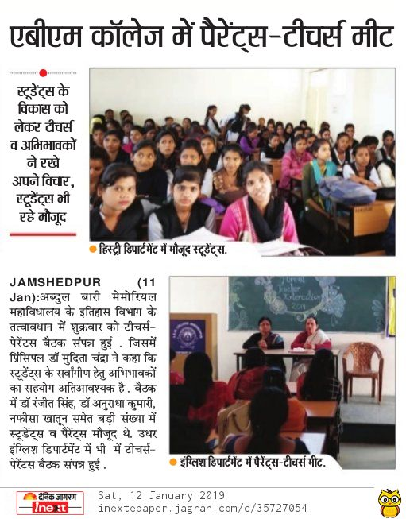
Details of student enrichment programme:

Slide 24
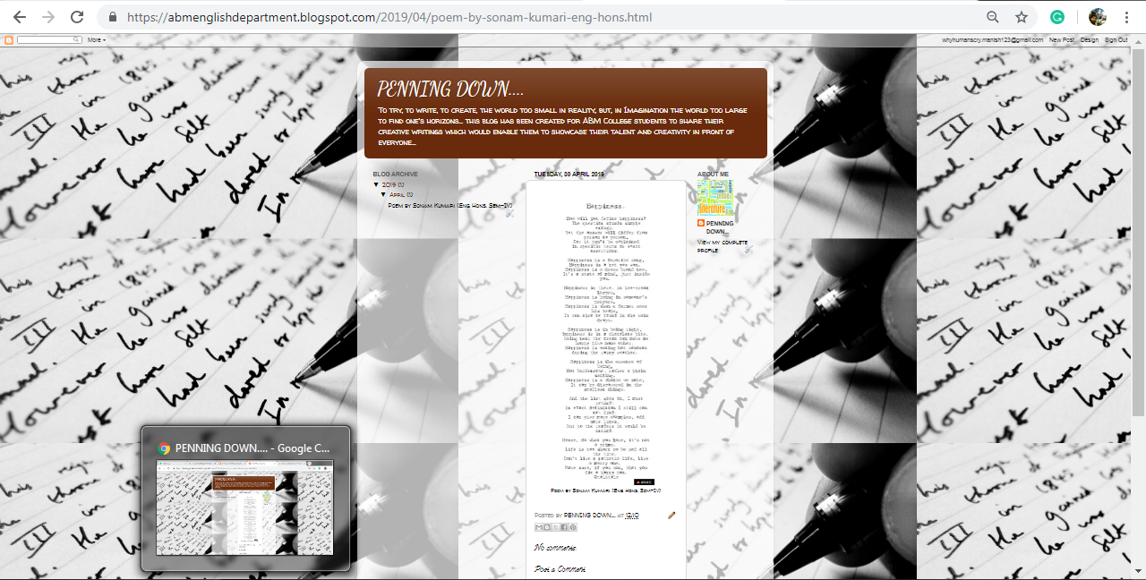
Departmental Blog
Blog website:-https://abmenglishdepartment.blogspot.com

Slide 25
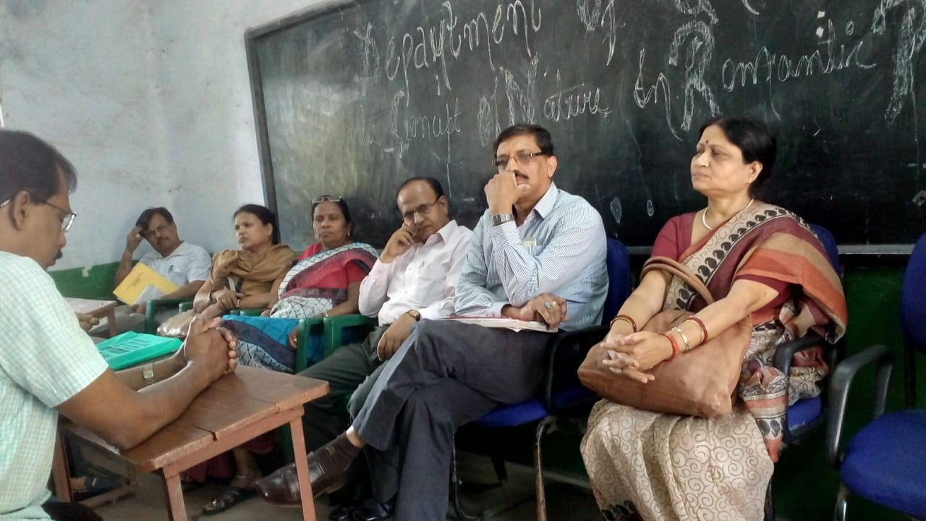
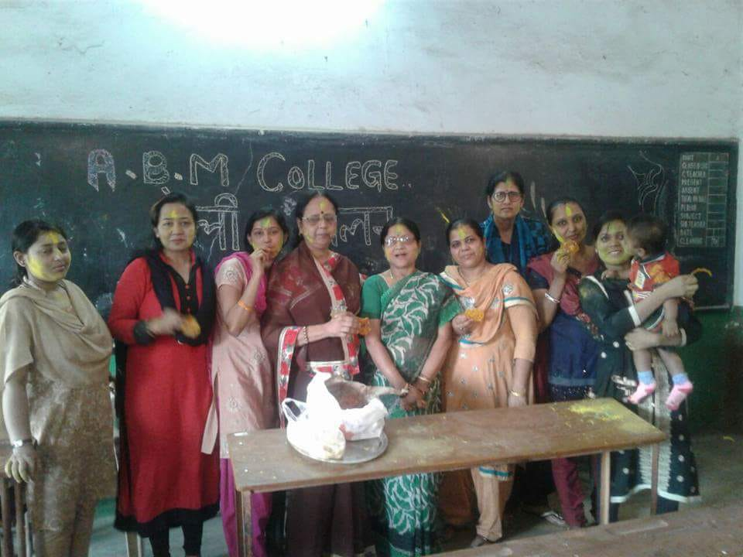
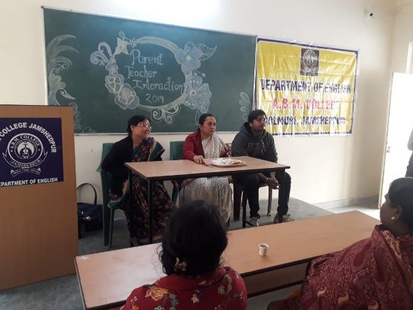
Events At English Department

Slide 26
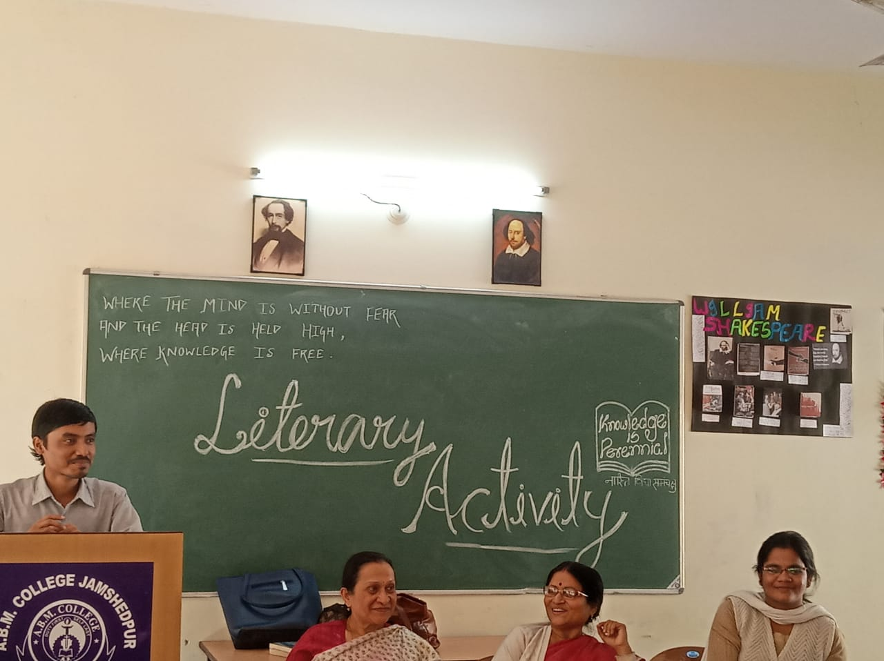
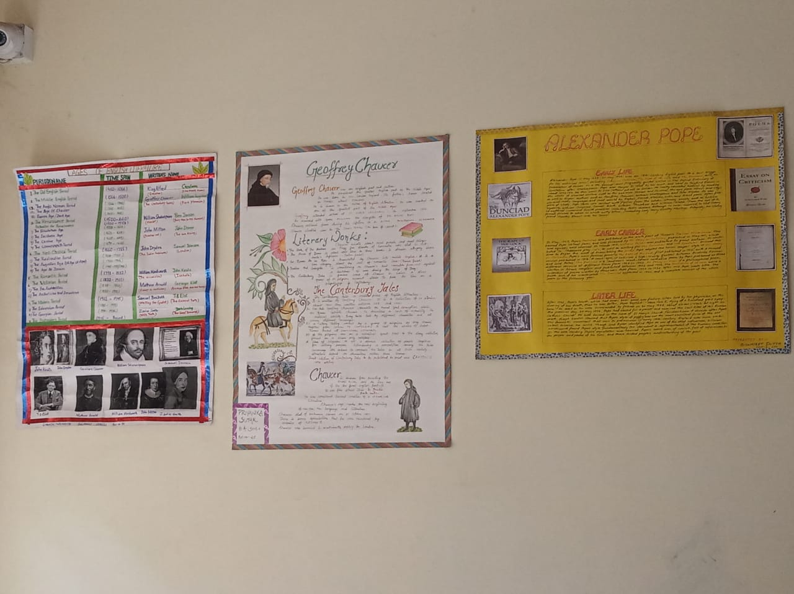
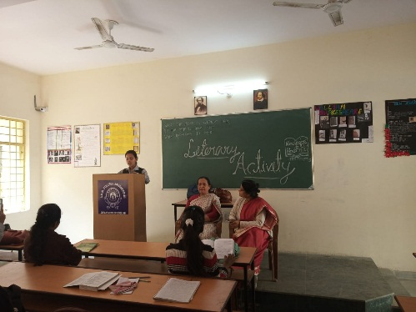
LITERARY ACTIVITIES…

Slide 27
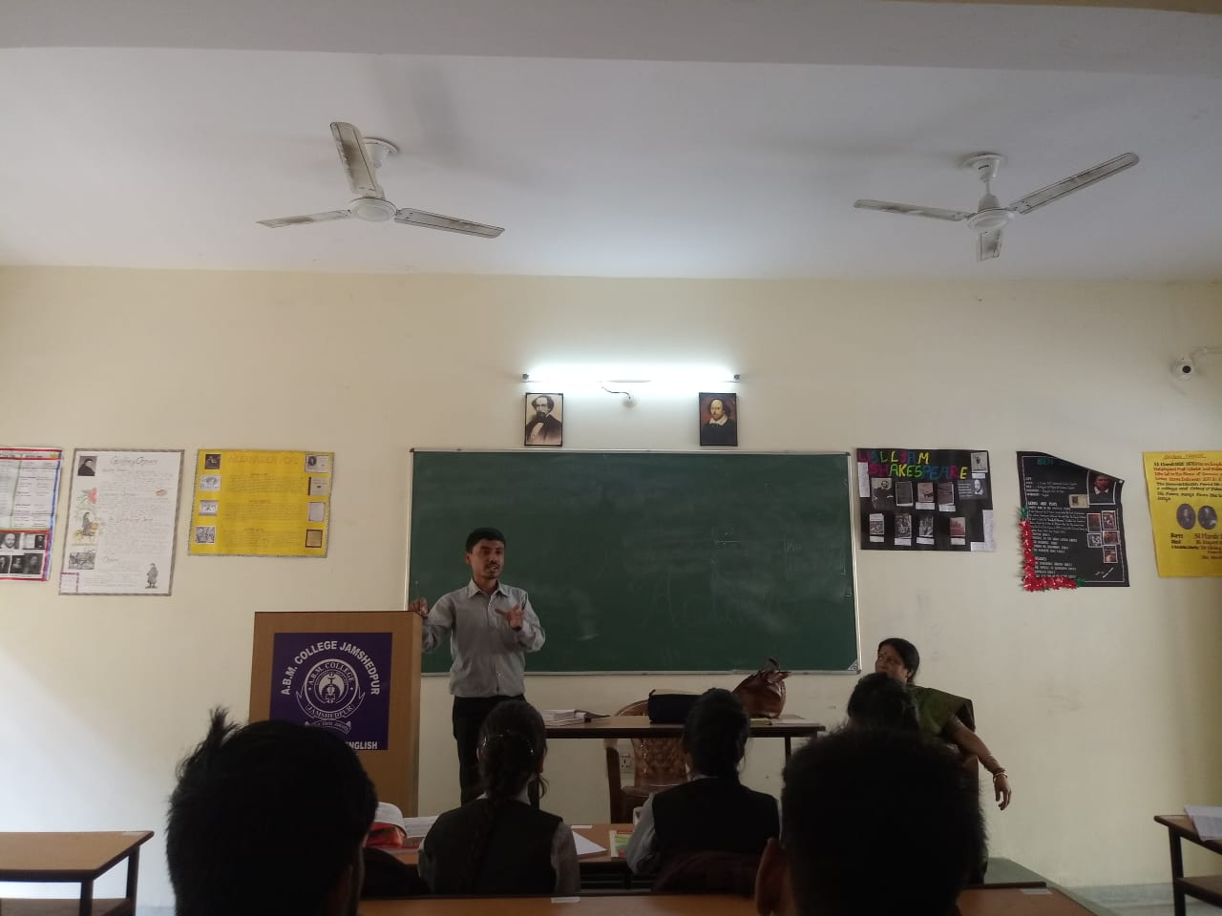
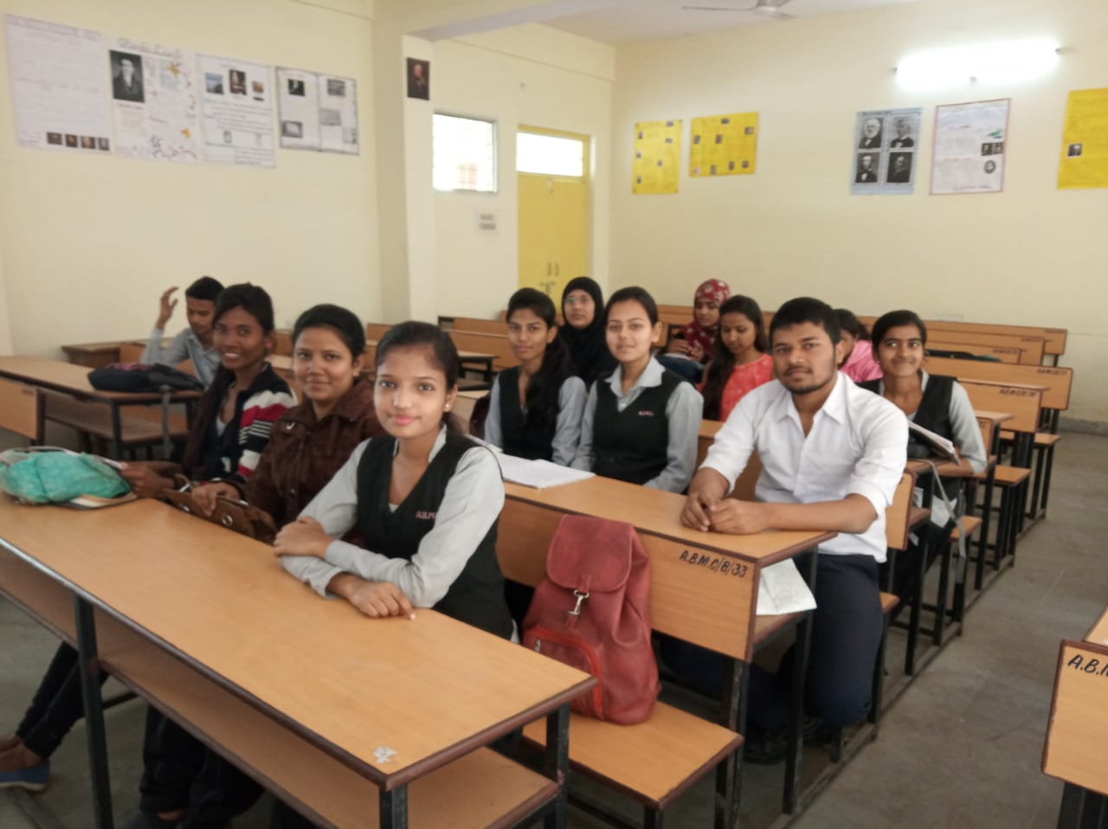
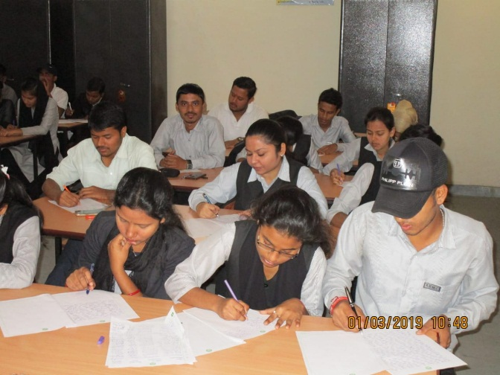
LITERARY ACTIVITIES…

Slide 28
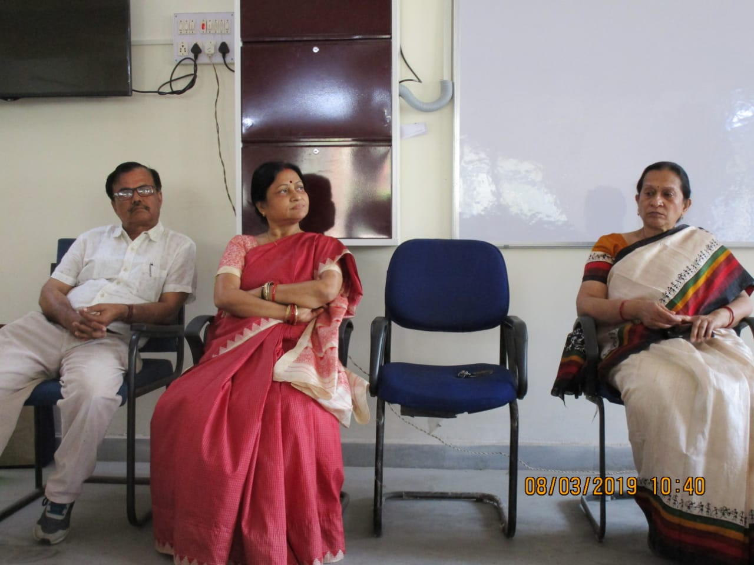
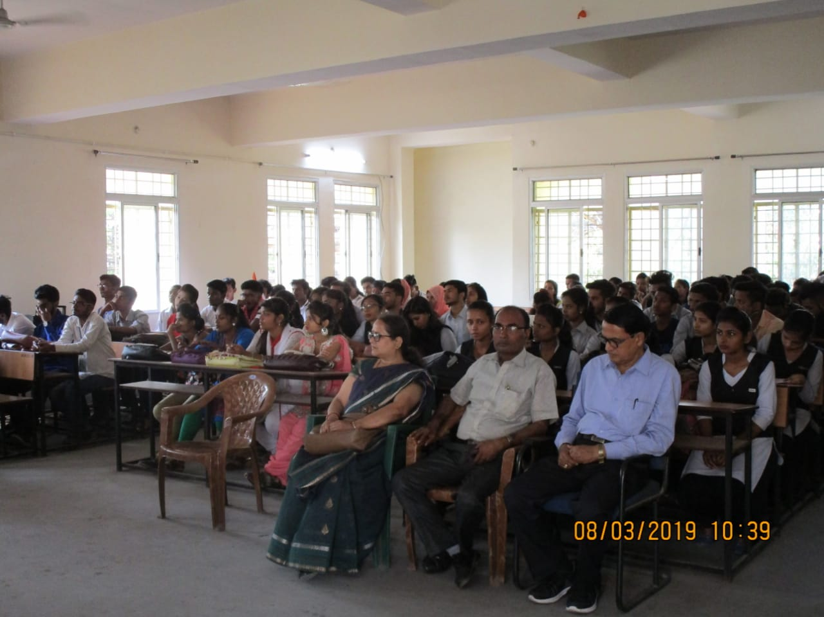
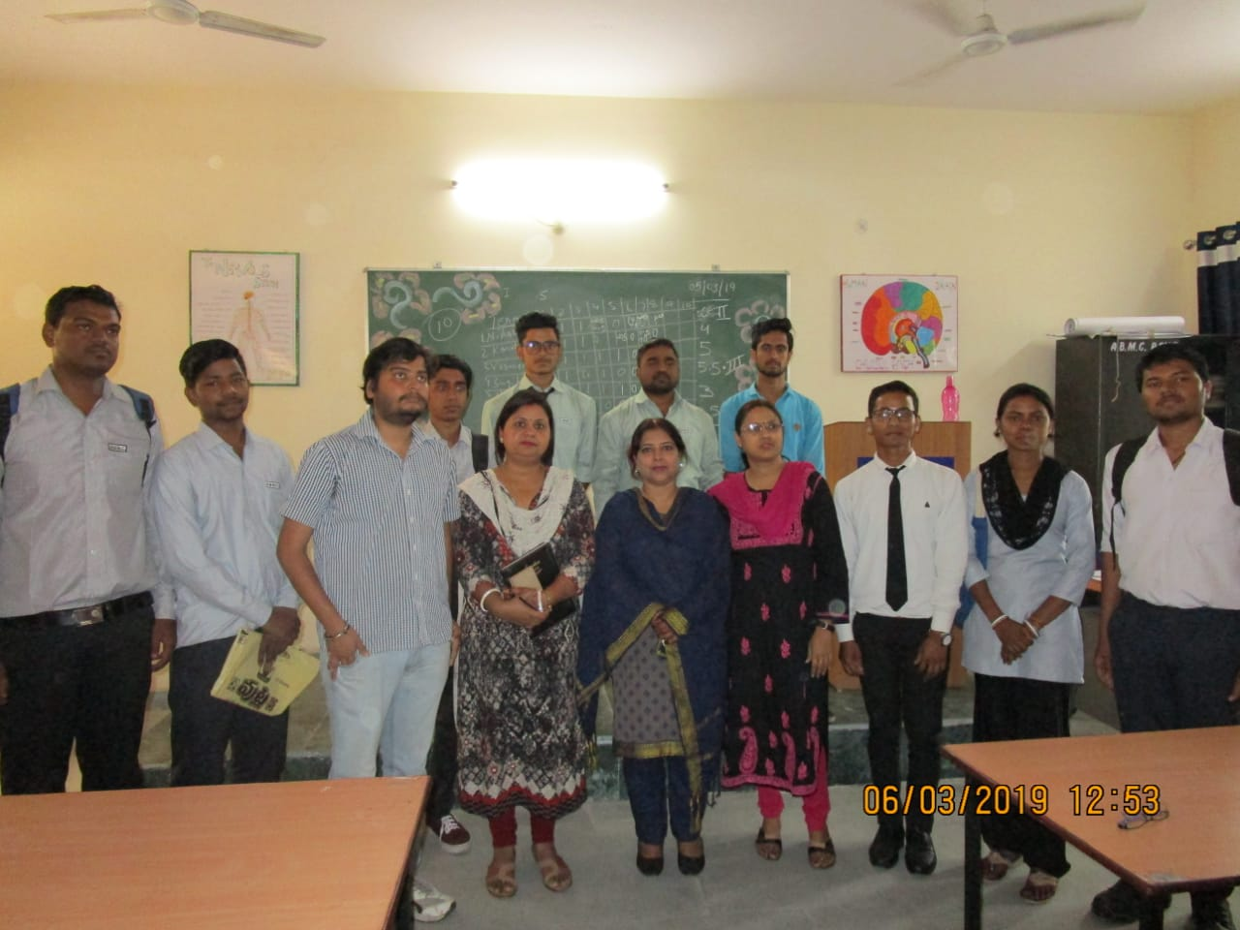
LITERARY ACTIVITIES…

Slide 29
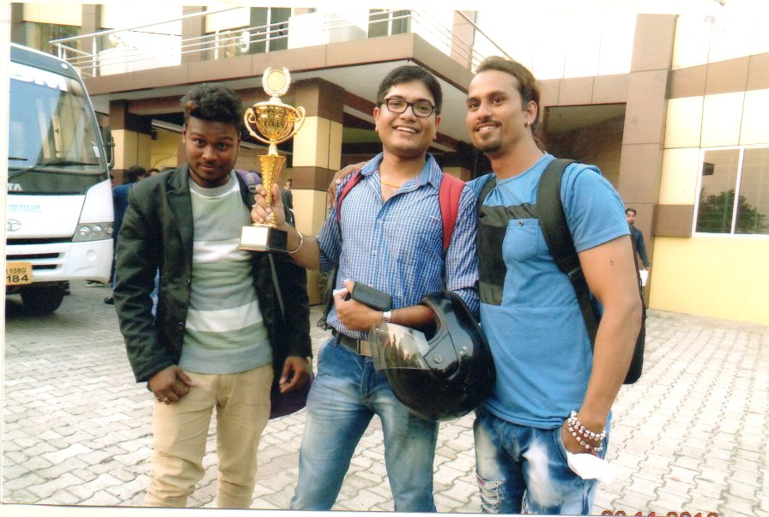
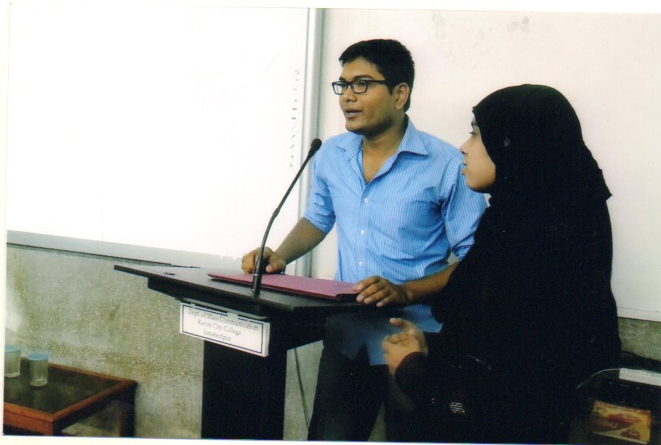
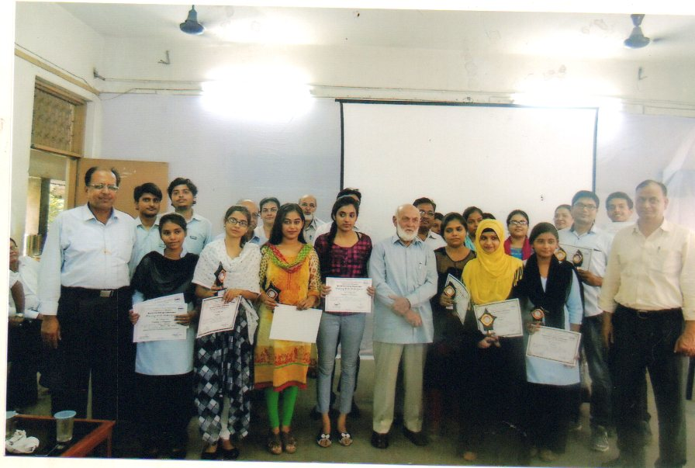
LITERARY ACTIVITIES…

Slide 30
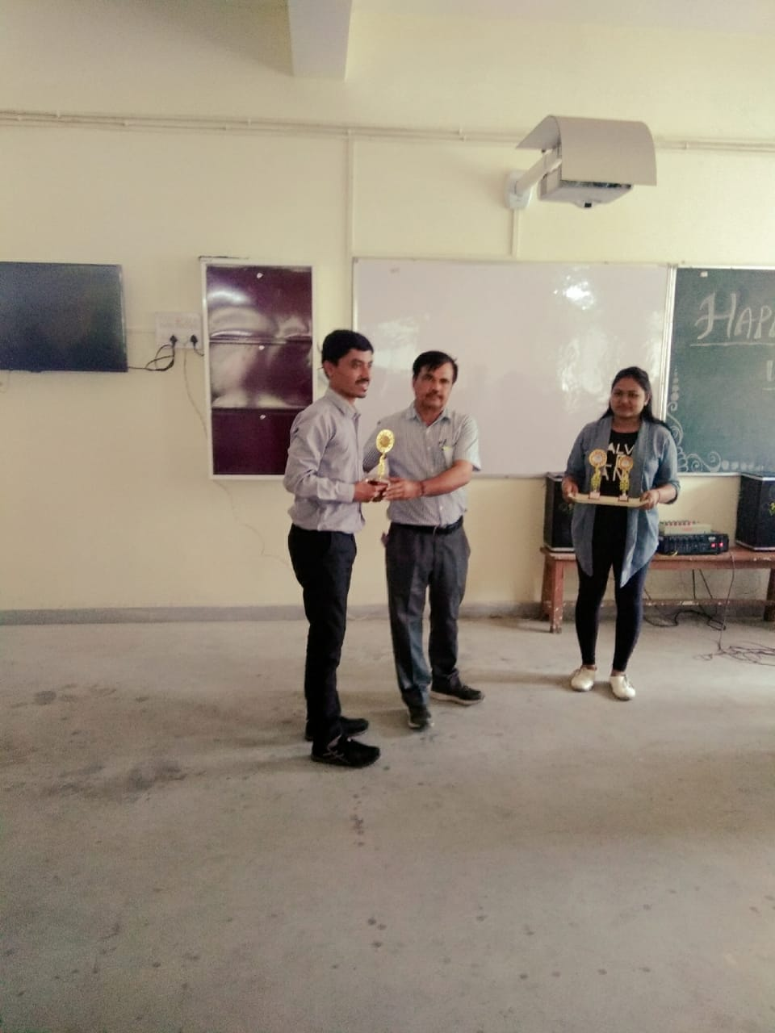
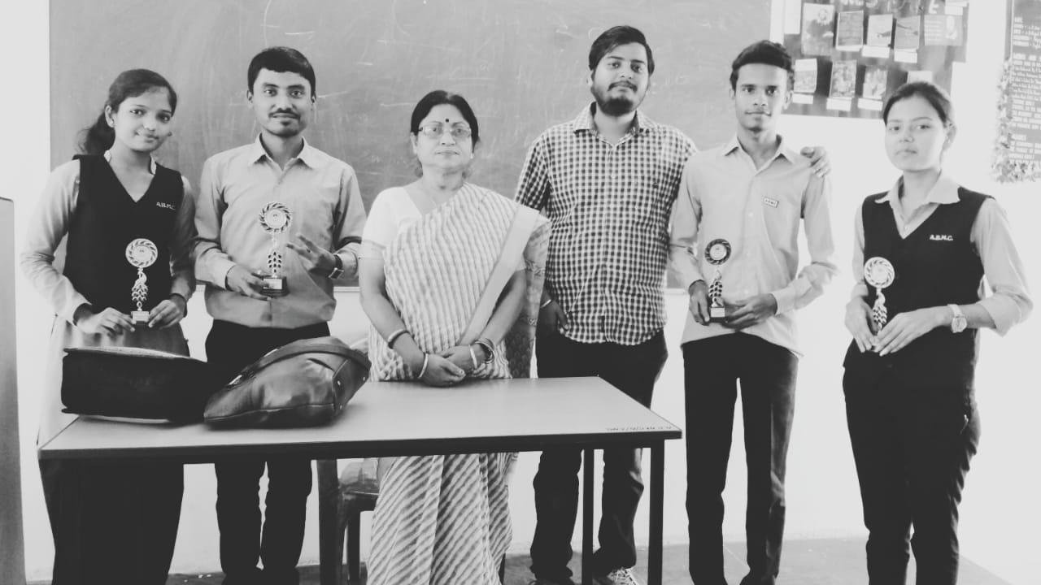
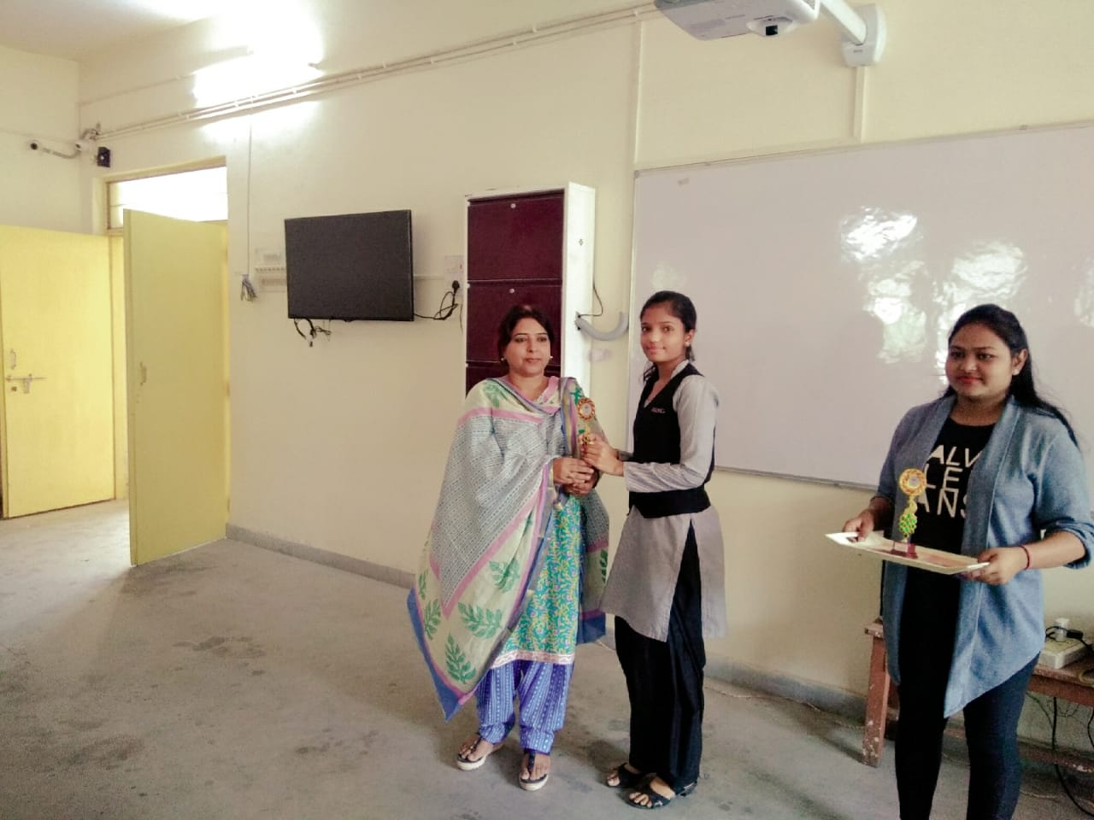
LITERARY ACTIVITIES…

Slide 31
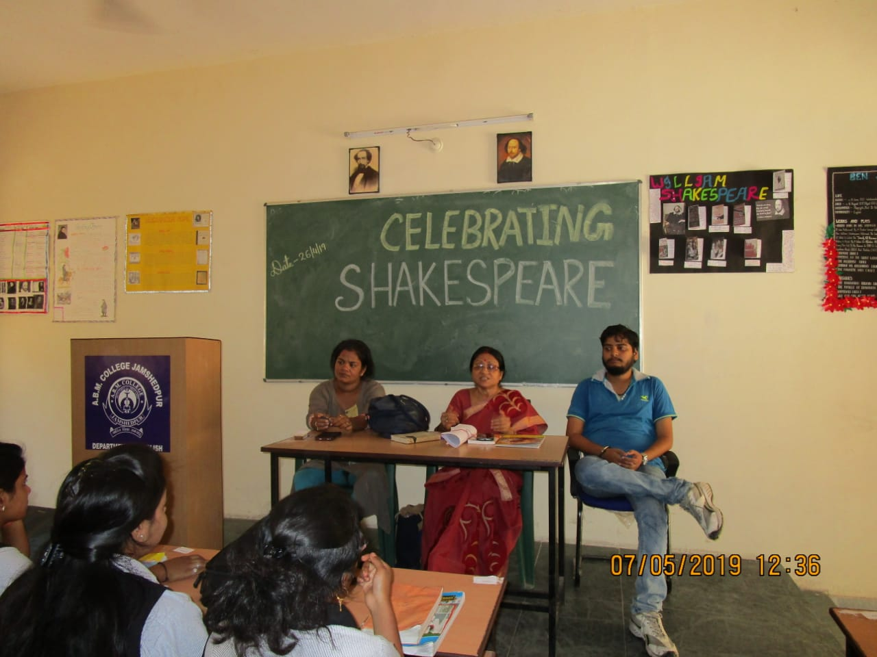
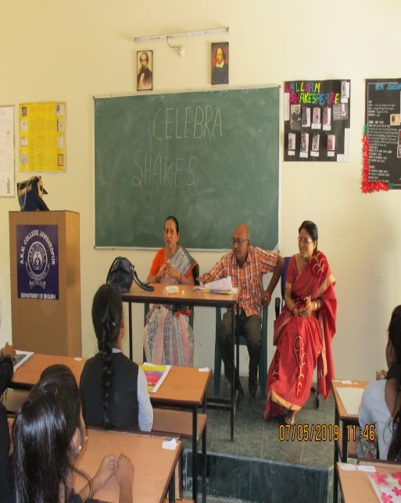
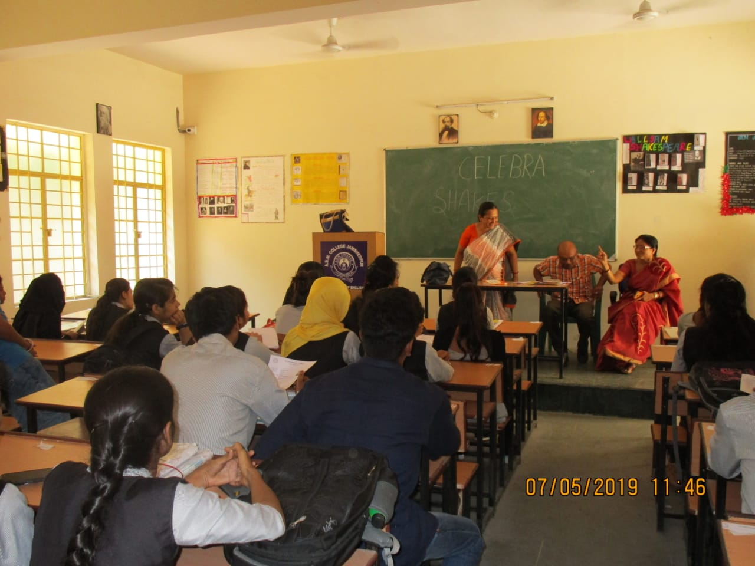
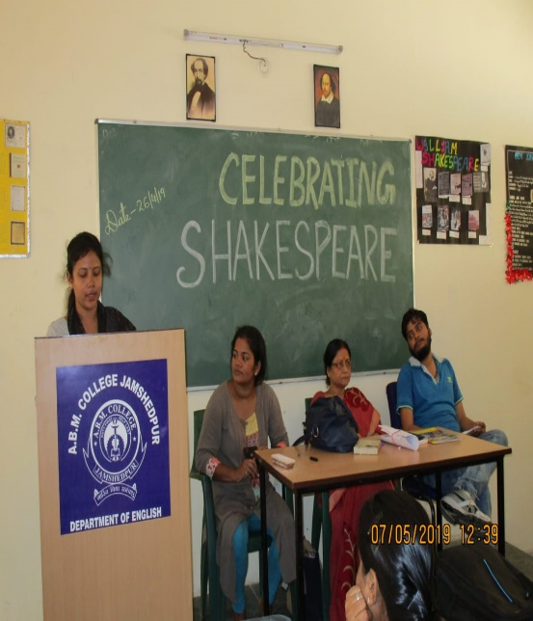
LITERARY ACTIVITIES…

Slide 32
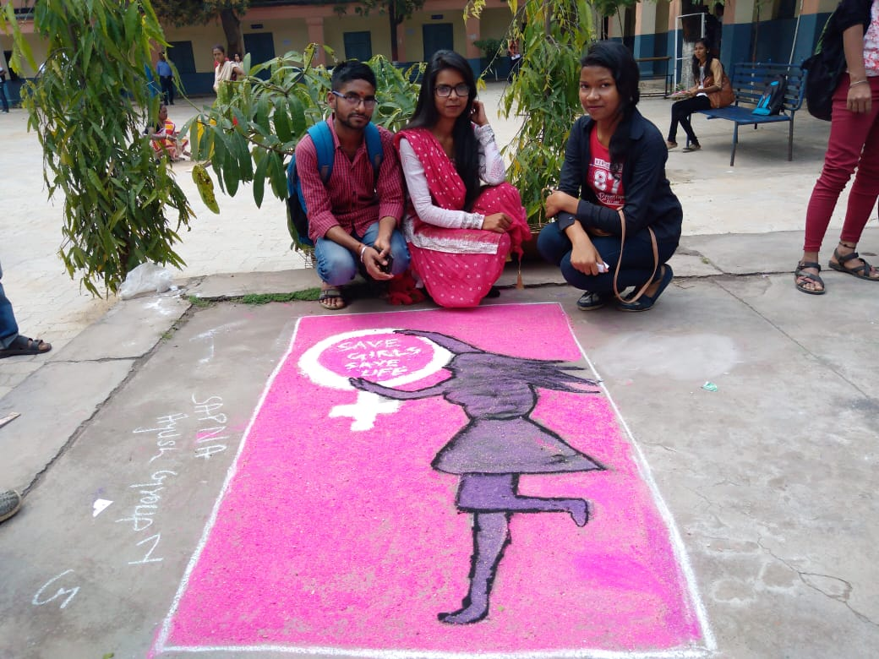
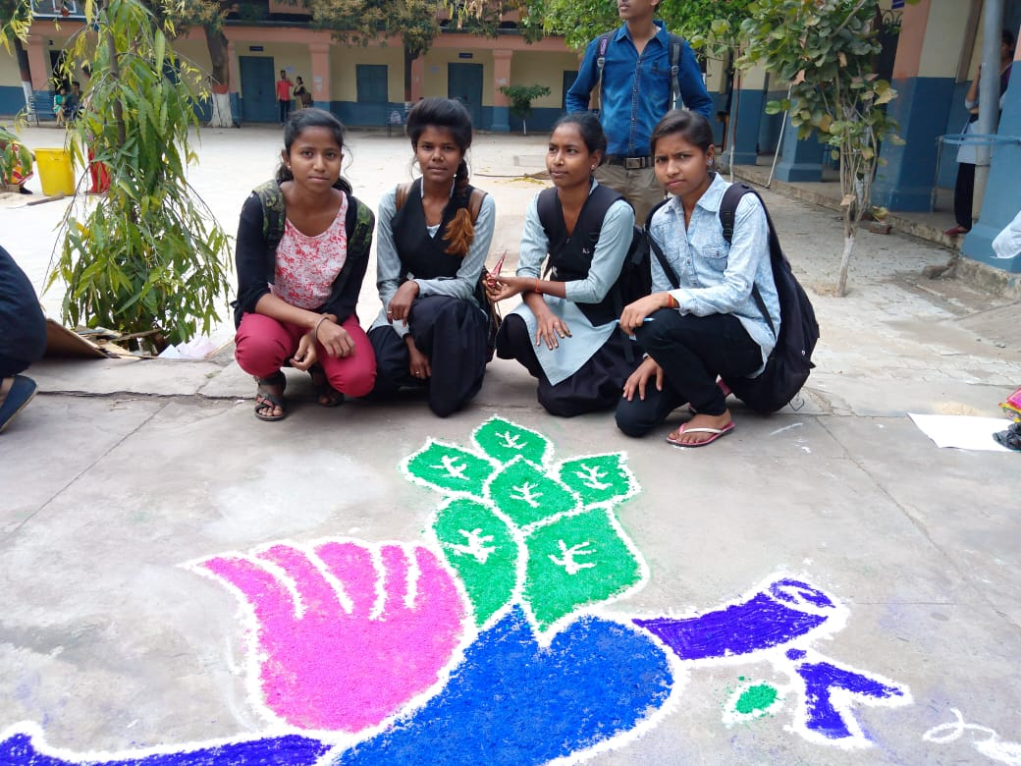
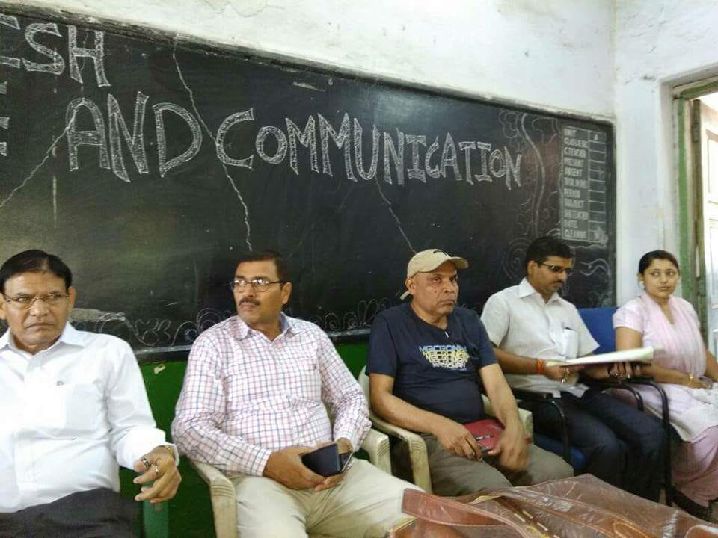
STUDENT ACTIVITIES…

Slide 33
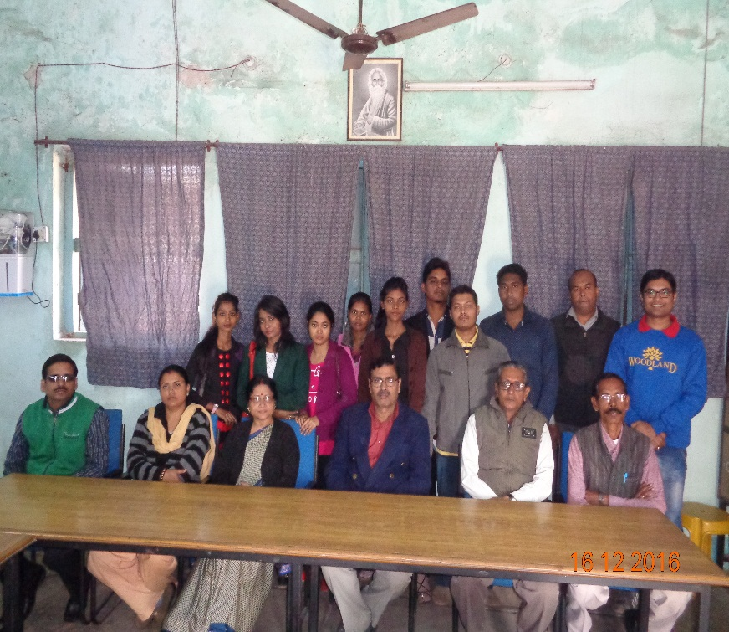
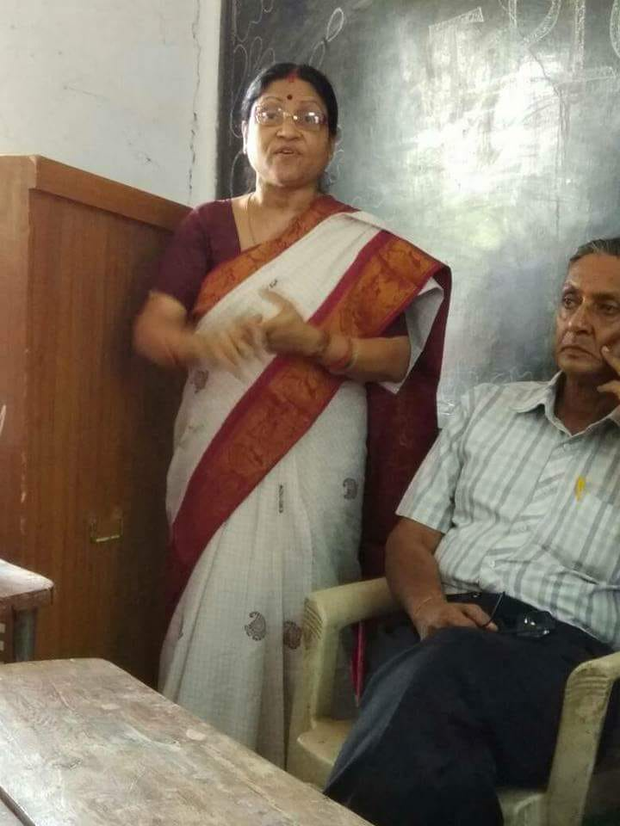
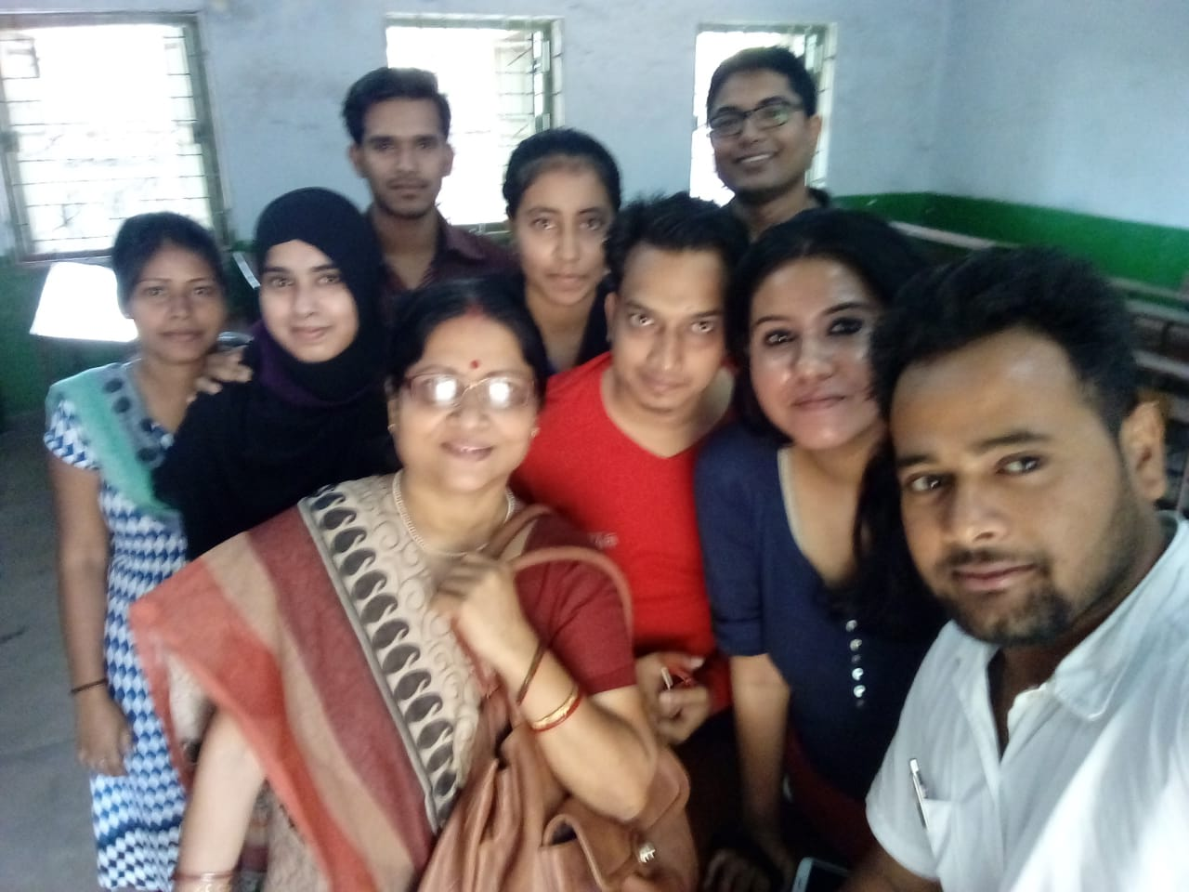
STUDENT ACTIVITIES…

Slide 34
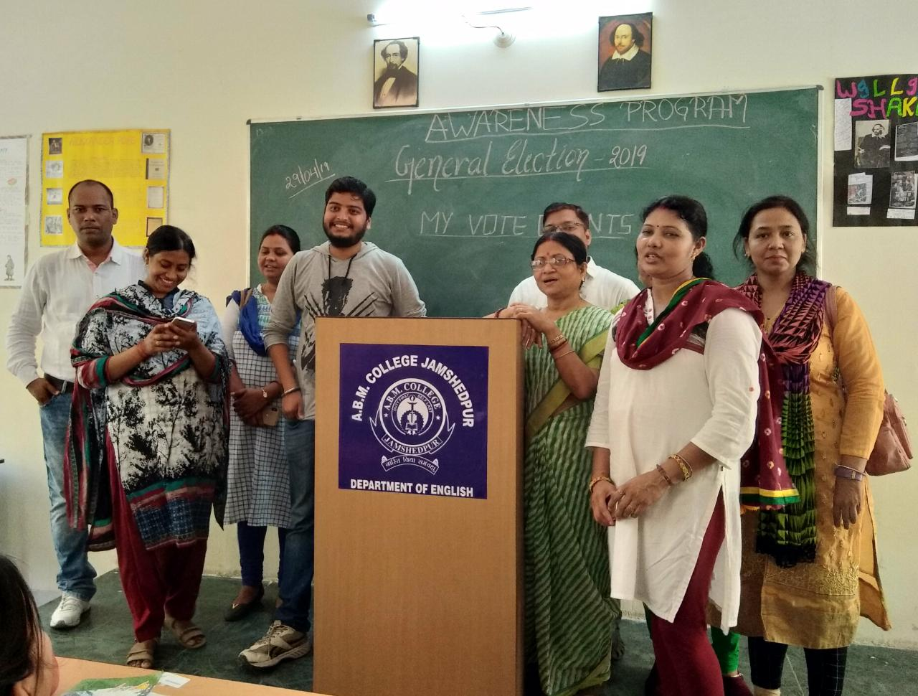
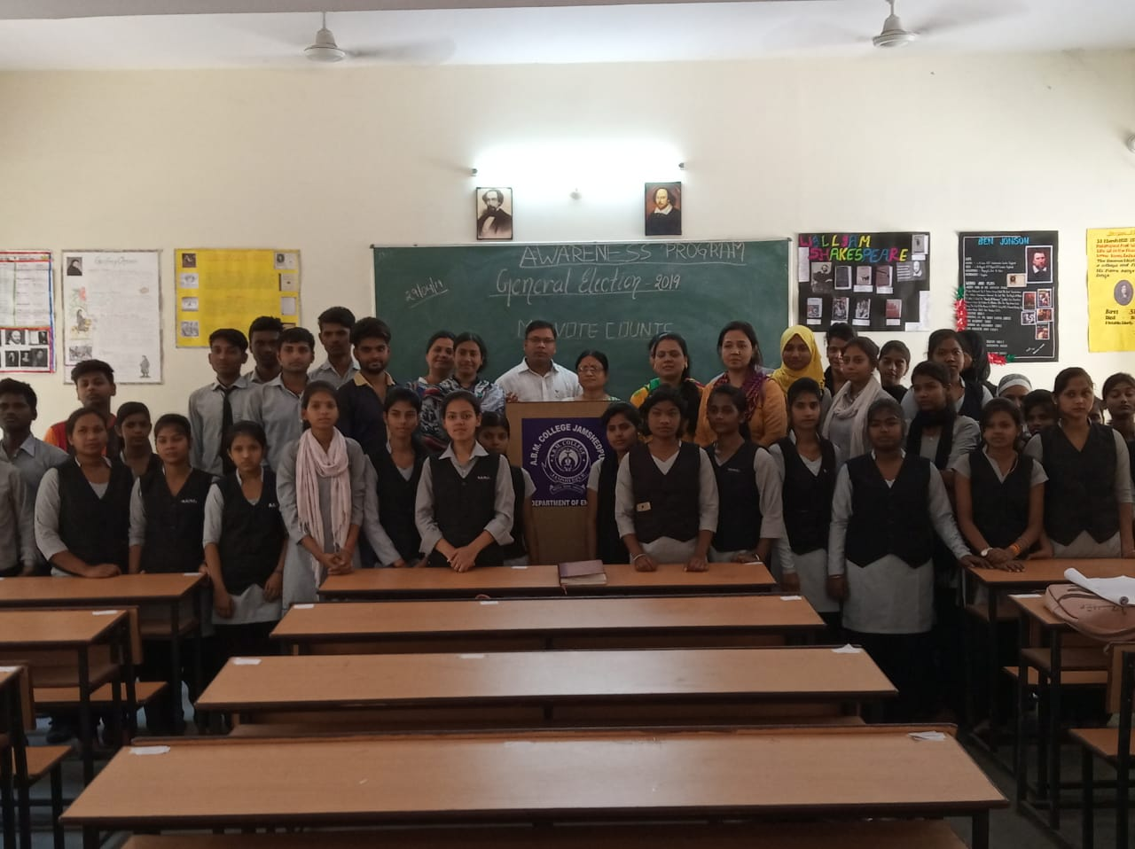
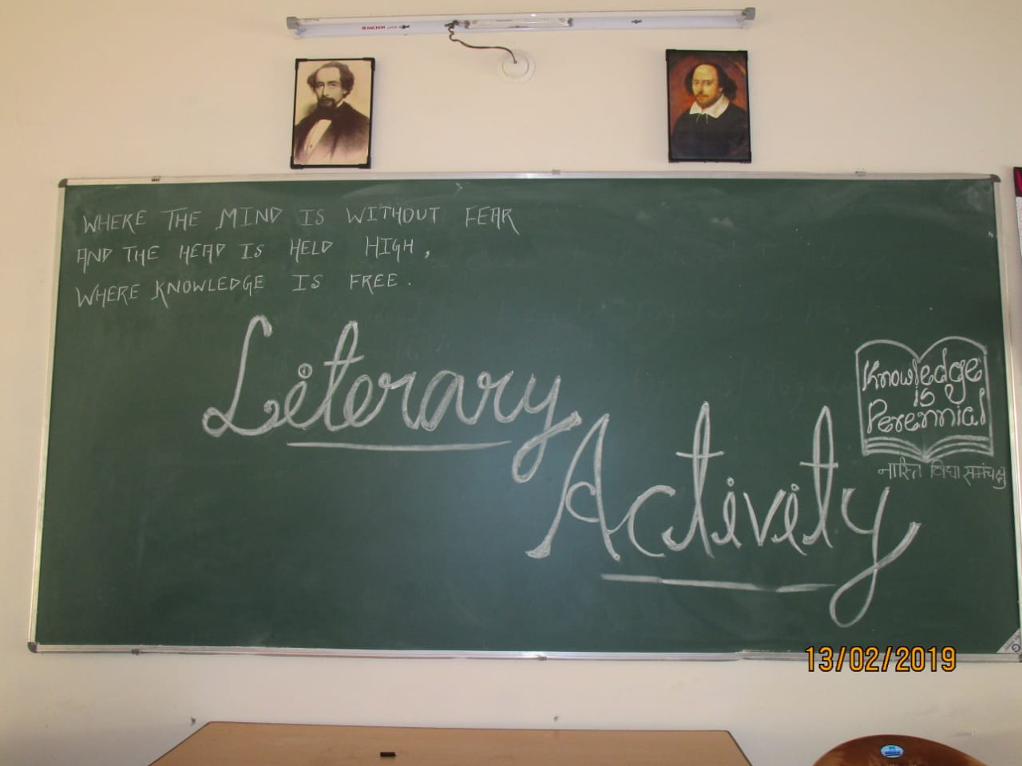
STUDENT ACTIVITIES…

Slide 35
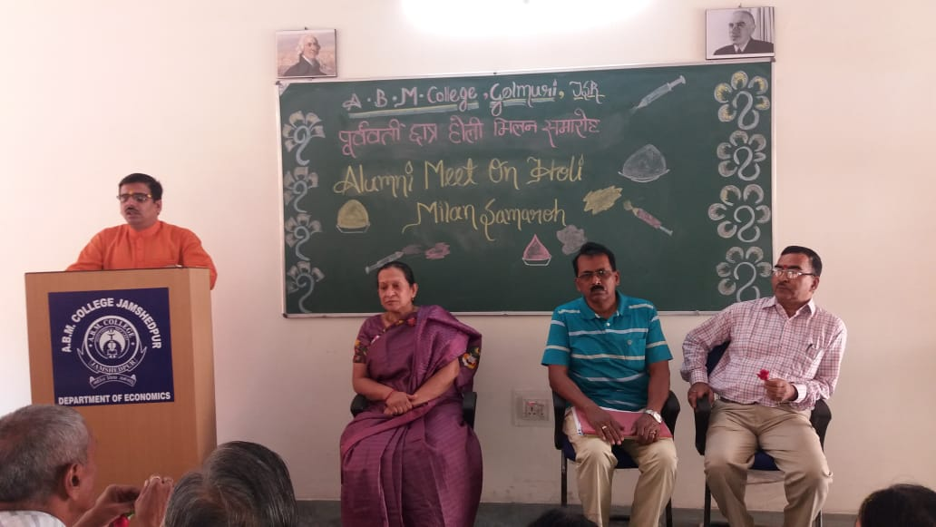
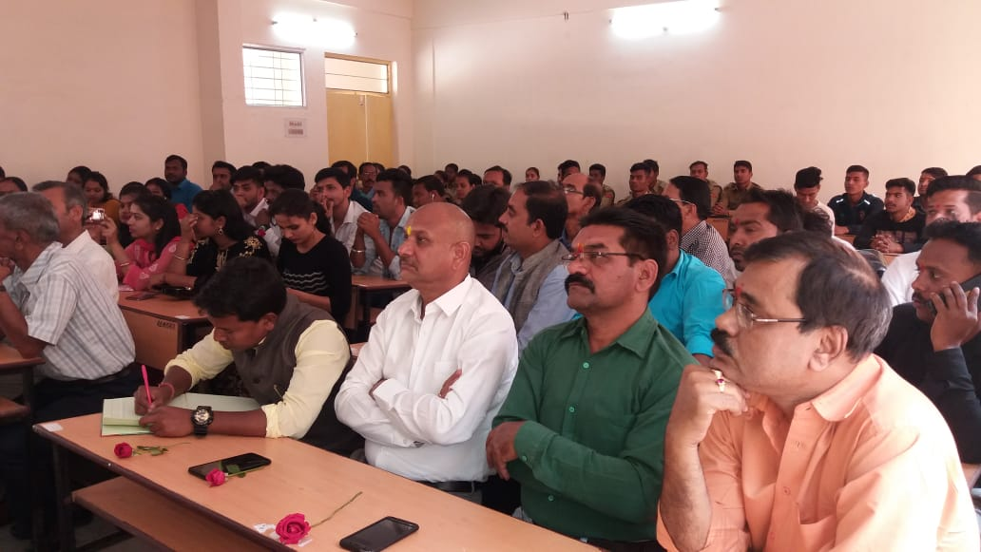
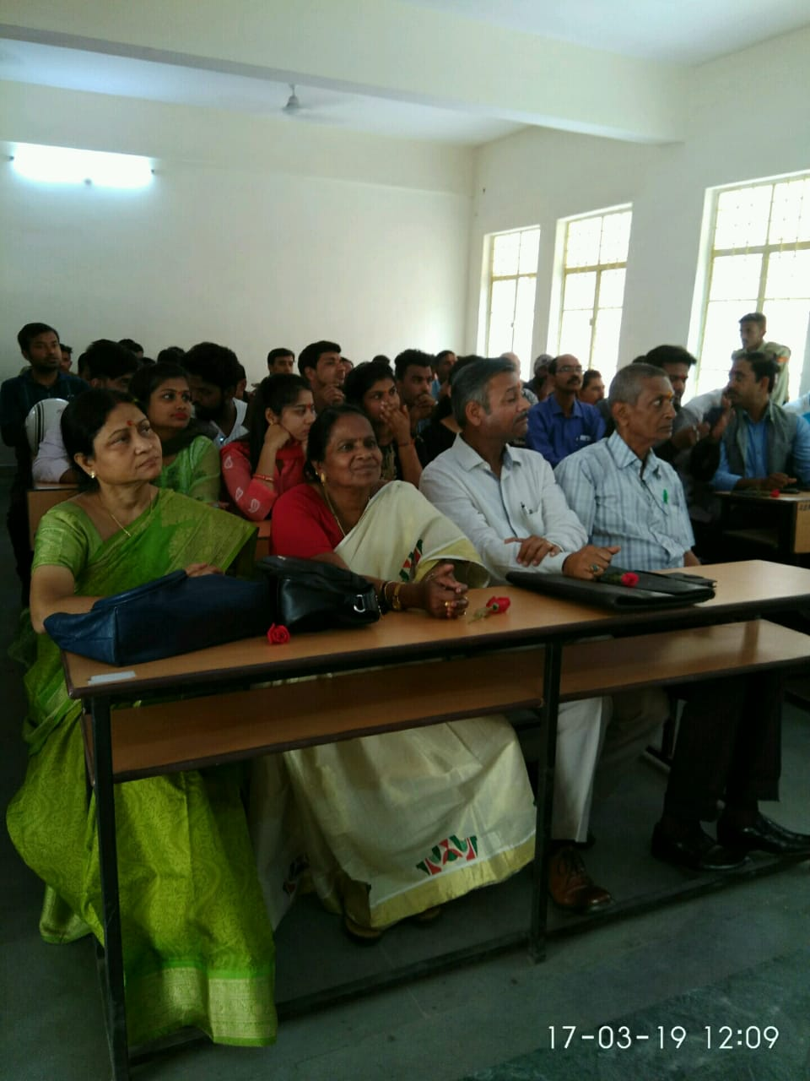
ALUMNI MEET…

Slide 36
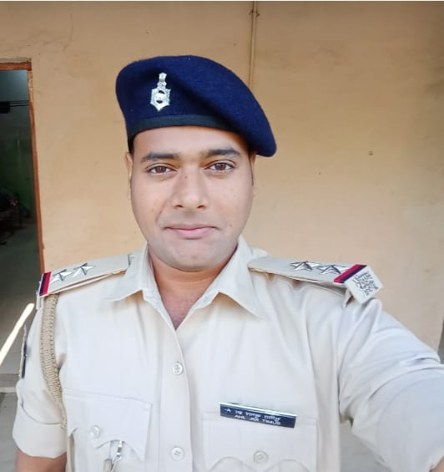
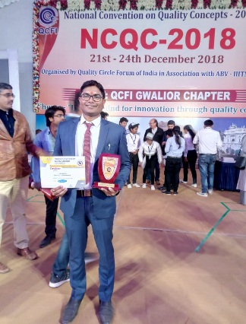
Departmental Alumni
Our alumni members constituting of our pass-out students of the last five years are making us proud through their accomplishments.
Anu Giri (2012-2015) is currently working in Think race Technology
Sumit Kumar Jha(2013-2016) is working as SI posted in Hazaribagh.
Hemlata(2013-2016) is currently working in Tata Motors.
Aman Singh(2013-2016) is currently working in Tata Motors.
Manish Kumar(2014-2017) is currently working in Tata Steel.
Sikha Sharma(2014-2017) currently working in DTDC.

Slide 37
Somnath Tiwary(2015-2018) is currently working in Tata Steel.
Sunita Gain(2015-2018) currently working in Shyann Kids Play School
Stella Dhanwar (2015-2018) is currently working in Tata Motors Hospital
Sanjay(2016-2019) is currently working in Reliance Fresh.
Gourav Ghosal (2016-2019) is working in Tata Motors.

Slide 38
Envisaging the Future
The Department, in the coming years, looks forward to the following projects:
Introduction of Post-graduate Teaching
Workshop on Creative Writing and Critical Theory
Workshop on Language, Vocabulary and Soft Skills
Organizing a National Seminar

